Slide 1
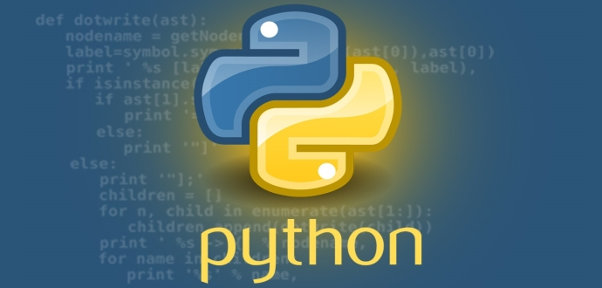
Avanceret Programmering Kristian Osbæck
Digital Munchkin

Slide 2
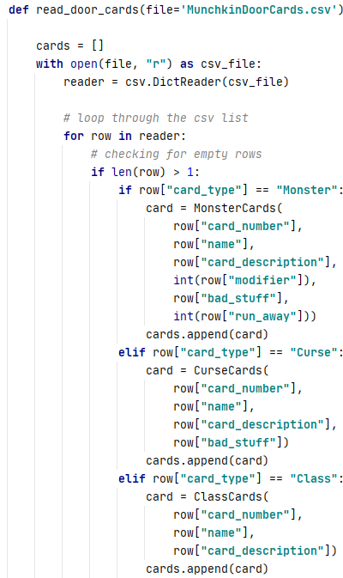
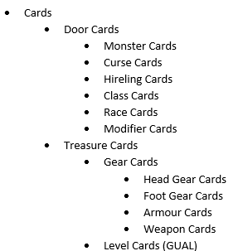
Indlæsning af kort
Indlæsning af kort
Hierarki

Slide 3
Player class
Indhold
type=None,
gender=None,
race="Human",
hand_cards=None,
table_cards=None,
player_class=None,
level=1,
level_total=1,
gold=0
De vigtigste metoder
check_hand_cards(self, card_type, item)
check_weapon_cards(self)
replace_weapon(self, old: Cards, new: Cards)
die(self)

Slide 4
Game class del 1 – metoder
decide_player_type(self)
pick_door_card(self) -> Cards
pick_treasure_card(self)
discard(self, card: TreasureCards)
replace(self, discard_card: TreasureCards, throw_card: TreasureCards)
change_player(self)
check_for_win(self)
check_active_player_cards(self)
calculate_monsterfight_computer(self, monster_card: MonsterCards)
calculate_monsterfight_human(self, monster_card: MonsterCards)
player_turn_calc_computer(self)
player_turn_calc_human(self)
discard_cards(self, discards: list, stack: list)

Slide 5
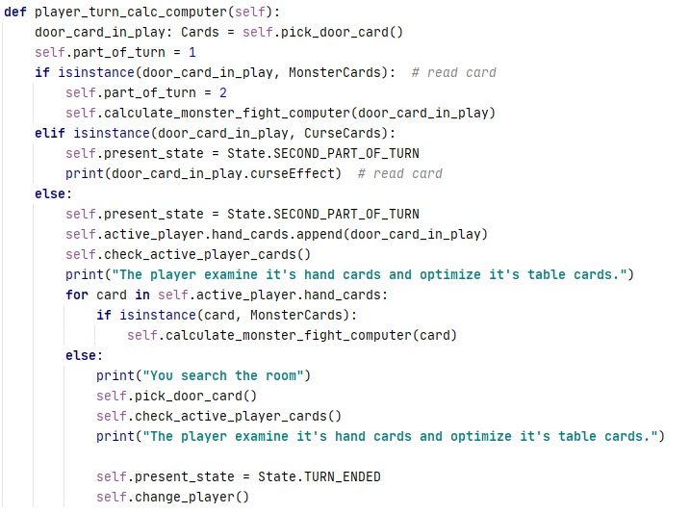
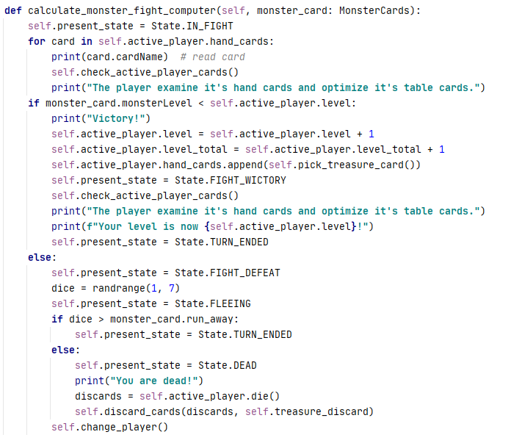
Game class del 2 – de to vigtigste
player_turn_calc_computer(self)
calculate_monster_fight_computer
(self, monster_card: MonsterCards)

Slide 6
Selve spillet

Slide 7
Print card

Slide 8
Søgefunktion – et planlægningsværktøj

